Slide 1
Computer Architecture
(fall 2021)
Lecture 4
Quantitative Approach
Dr. Yujuan Tan (谭玉娟)
Office: Main Building 0626
Email: tanyujuan@cqu.edu.cn

Slide 2
Computer Architects and Quantitative Approach
• Design ideas and trade-offs are tested by using tools in order to estimate the impact on performance, power and cost (an iterative process)
– analytical reasoning and fundamental design principles
– equations for basic metrics
• cost, performance, power…
– simulations at various levels
• system level, ISA, micro-architecture, memory , RTL, gate,
circuit level
– benchmark programs representing typical workloads
Notes:
使用工具测试 设计思想和权衡，以估计对性能、功耗和成本的影响（一个迭代过程）
– 分析推理和基本设计原则
– 基本指标的方程式
• 成本、性能、功耗……
– 不同级别的模拟
• 系统级、ISA、微架构、内存、RTL、门、
电路级
– 代表典型工作负载的基准程序

Slide 3
Power and Energy
Problem: Get power in, get power out
Thermal Design Power (TDP)
  Characterizes sustained power consumption
  Used as target for power supply and cooling system
  Lower than peak power, higher than average power consumption
Clock rate can be reduced dynamically to limit power consumption
Energy per task is often a better measurement
Notes:
问题：通电，断电
热设计功耗 (TDP)
表征持续功耗
用作电源和冷却系统的目标
低于峰值功率，高于平均功耗
可以动态降低时钟速率以限制功耗
每项任务的能量通常是更好的衡量标准

Slide 4
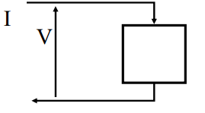
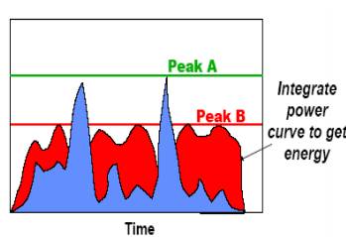
Power and Energy
• Energy
– measured in Joules
• Power
– rate of energy consumption
• [Watts = Joules/sec]
– instantaneous power P = V * I
• voltage drop across a component
times the current flowing through it
• Example
– system A
• higher peak power
• lower total energy
– system B
• lower peak power
• higher total energy
Notes:
• 能耗 – 以焦耳为单位
• 功率
– 能源消耗率 • [瓦特 = 焦耳/秒]
– 瞬时功率 P = V * I
• 组件上的压降乘以流过它的电流
• 例子
– 系统 A • 更高的峰值功率 • 降低总能量
– 系统 B • 降低峰值功率 • 更高的总能量

Slide 5
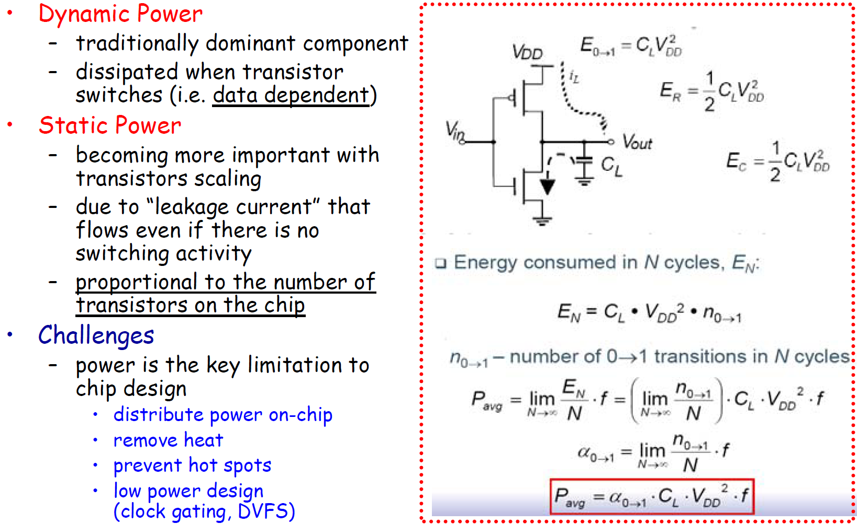
Power Consumption of CMOS Transistors
Notes:
动力
-传统优势成分
-晶体管开关时耗散（即数据相关
静功率
-随着晶体管规模的扩大，它变得越来越重要
-因为即使没有开关活动，也会有“泄漏电流”流动
-与芯片上晶体管的数量成比例
挑战
-功耗是芯片设计的关键限制
--片上分布式电源
--散热
--防止热点
--慢功率设计（时钟选通、DVFS）

Slide 6
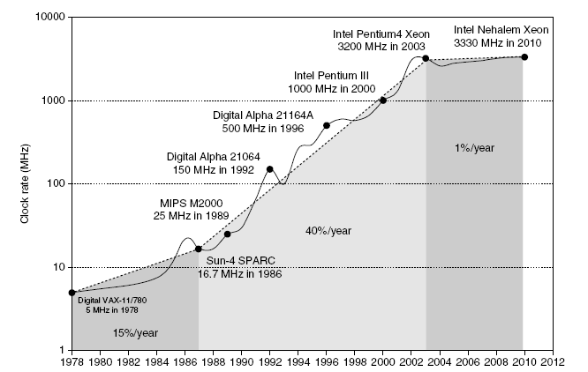
Power
Intel 80386 consumed ~ 2 W
3.3 GHz Intel Core i7 consumes 130 W
Heat must be dissipated from 1.5 x 1.5 cm chip
This is the limit of what can be cooled by air
Notes:
英特尔80386耗电约2瓦
3.3 GHz Intel Core i7耗电130 W
必须从1.5 x 1.5 cm的芯片中散热
这是空气冷却的极限

Slide 7
Dynamic Energy and Power
Dynamic energy
  Transistor switch from 0 -> 1 or 1 -> 0
Dynamic power
  1/2 电容性负载 电压2 频率开关
Reducing clock rate reduces power, not energy
Notes:
动力能
晶体管从0->1或1->0切换
动力降低时钟频率会降低功率，而不是能量

Slide 8
Reducing Dynamic Power
Techniques for reducing power:
  Do nothing well
  Dynamic Voltage-Frequency Scaling (DVFS)
  Low power state for DRAM, disks
  Overclocking, turning off cores
Notes:
降低功率的技术：
一事无成
动态电压频率缩放（DVFS）
DRAM、磁盘的低功耗状态
超频，关闭核心

Slide 9
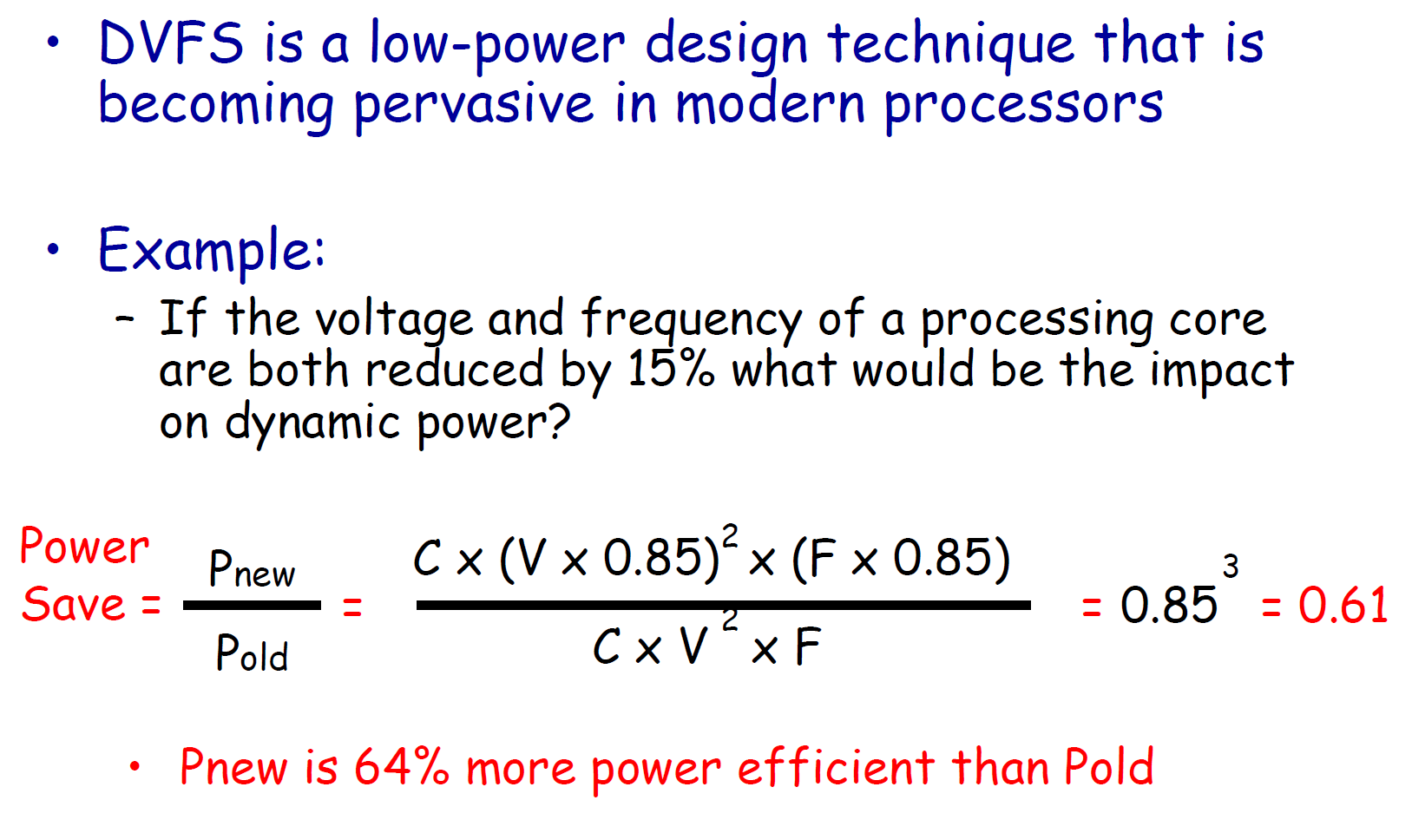
Dynamic Voltage Frequency Scaling
Example: H&P5th P23
61%

Slide 10

Static Power
Static power consumption
  Scales with number of transistors
  To reduce: power gating

Slide 11
Trends in Cost
Cost driven down by learning curve
  Yield
DRAM: price closely tracks cost
Microprocessors: price depends on volume
  10% less for each doubling of volume

Slide 12
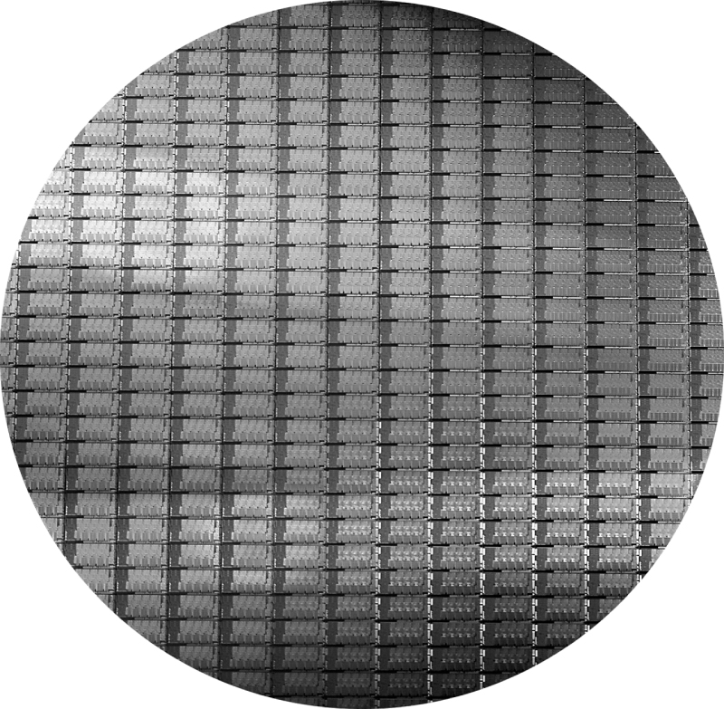
Integrated Circuit Cost
This 300 mm wafer contains 280 full Sandy Bridge dies, each 20.7 by 10.5 mm in a 32 nm process. (Sandy Bridge is Intel’s successor to Nehalem used in the Core i7.) At 216 mm2, the formula for dies per wafer estimates 282. (Courtesy Intel.)

Slide 13



Integrated Circuit Cost
Integrated circuit
Bose-Einstein formula:
Defects per unit area = 0.016-0.057 defects per square cm (2010)
N = process-complexity factor = 11.5-15.5 (40 nm, 2010)
Example: H&P 5th P31

Slide 14
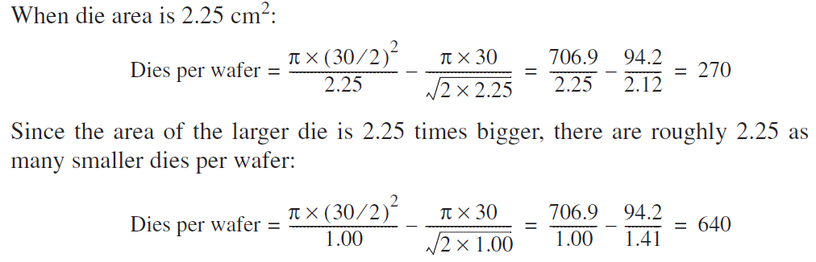
Integrated Circuit Cost: Example
Example: H&P 5th P31
Answer
Notes:
对于侧边为1.5 cm的模具和侧边为1.0 cm的模具，找出每300 mm（30 cm）晶圆的模具数量

Slide 15
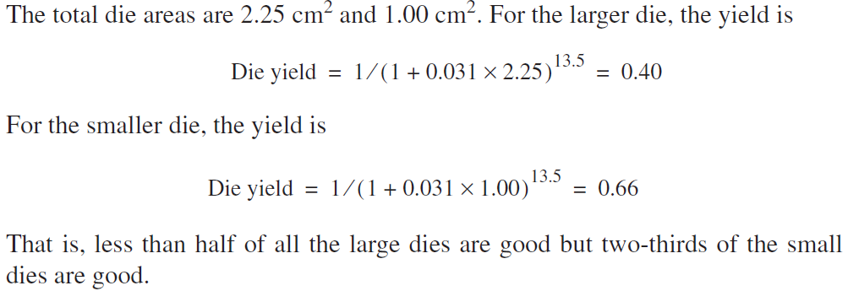
Integrated Circuit Cost: Example
Example: H&P 5th P31
Answer
Notes:
找到一侧为1.5 cm、一侧为1.0 cm的模具的模具尺寸。假设缺陷密度为0.031/cm，Nis为13.5

Slide 16
How to Define Performance?
Airplane | Passenger Capacity | Cruising Range (miles) | Cruising Speed (m.p.h.) | Passenger Throughput (passenger x m.p.h)
Boeing 777 | 370 | 4630 | 610 | 225,700
Boeing 747 | 470 | 4150 | 610 | 286,700
Concorde | 132 | 4000 | 1350 | 178,200
Douglas DC-8-50 | 146 | 8720 | 544 | 79,424

Slide 17
Two Key Performance Metrics
• Time to run the task
– execution time, response time, elapsed time, latency
• Tasks per time unit
– execution rate, bandwidth, throughput
Airplane | DC to paris | Speed | Passengers | Throughput (passengers x mph)
Boeing 747 | 6.5 hours | 610 mph | 470 | 286,700
Concorde | 3 hours | 1350 mph | 132 | 178,200

Slide 18
Latency vs. Throughput
• Latency
– “real” time necessary to complete a task
– important when the focus is on a single task
• a computer user who is working with a single application
• a critical task of a real-time embedded system
• Throughput (aka Bandwidth)
– number of tasks completed per unit of time
– a metric independent from the exact number of
executed tasks
– important when the focus is on running many tasks
• a manager of a large data-processing center is interested
in the total amount of work done in a given time
Notes:
•延迟
–完成任务所需的“实时”时间
–当重点放在单个任务上时，这一点很重要
•使用单个应用程序的计算机用户
•实时嵌入式系统的关键任务
•吞吐量（又名带宽）
–单位时间内完成的任务数
–独立于已执行任务的确切数量的度量
–当重点放在运行许多任务时，这一点很重要
•大型数据处理中心的经理感兴趣
在给定时间内完成的总工作量

Slide 19
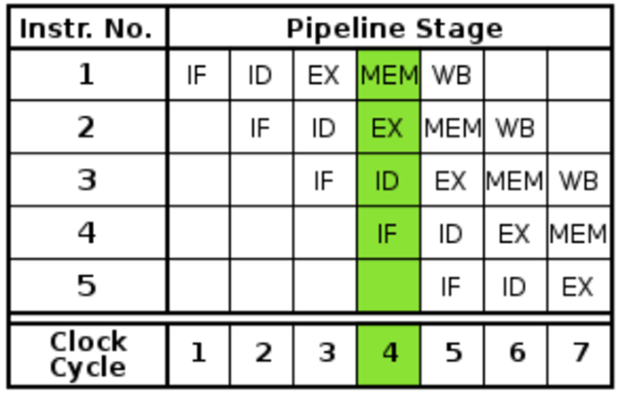
Latency and Throughput-The Classic 5-Stage Pipeline
• Pipelining
– increases the instruction throughput
• number of instructions completed per unit of time
– but does not reduce (in fact, it usually slightly increases) the execution time of an individual instruction

Slide 20
Performance Metrics
• Machine X is n times faster than machine Y
• Performance and execution time are reciprocal
– improve performance → increase performance
– improve execution time → decrease execution time
• Example
– executionTime(Y) = 4.8, executionTime(X) = 3.6
• n = 1.33, i.e. X is 33% faster than Y

Slide 21
Benchmark Suites
• Sets of programs to simulate typical workloads
• Several types
– real software applications (GCC, Word,…)
• most accurate but typically longer to process
• portability problems (OS/compiler dependencies), GUI
– kernels (Livermore Loops, Linpack,…)
• small, key pieces taken from real programs
• limited picture, but good to isolate the performance of
individual features of a machine
– synthetic benchmarks (Whetstone, Dhrystone,…)
• try to match the average frequency of operations on operands
of a real program
Notes:
•模拟典型工作负载的程序集
•几种类型
–真实软件应用程序（GCC、Word等）
•最准确，但处理时间通常较长
•可移植性问题（操作系统/编译器依赖项），GUI
–内核（利弗莫尔循环、Linpack等）
•从实际程序中提取的小型关键部件
•图片有限，但有助于隔离
机器的个别特征
–合成基准（Whetstone、Dhrystone等）
•尝试匹配操作数上的平均操作频率
一个真正的程序
•模拟典型工作负载的程序集
•几种类型
–真实软件应用程序（GCC、Word等）
•最准确，但处理时间通常较长
•可移植性问题（操作系统/编译器依赖项），GUI
–内核（利弗莫尔循环、Linpack等）
•从实际程序中提取的小型关键部件
•图片有限，但有助于隔离
机器的个别特征
–合成基准（Whetstone、Dhrystone等）
•尝试匹配操作数上的平均操作频率
一个真正的程序

